Slide 1
Whole Network Level

Slide 2
Levels of Analysis in social networks
Individual
1
Dyads
2
Triads
3
Cliques, Communities
4
Whole Network
5
The first part of the course follows this organization!

Slide 3
Levels of Analysis in social networks
Individual
1
Dyads
2
Triads
3
Cliques, Communities
4
Whole Network
5
The first part of the course follows this organization!

Slide 4
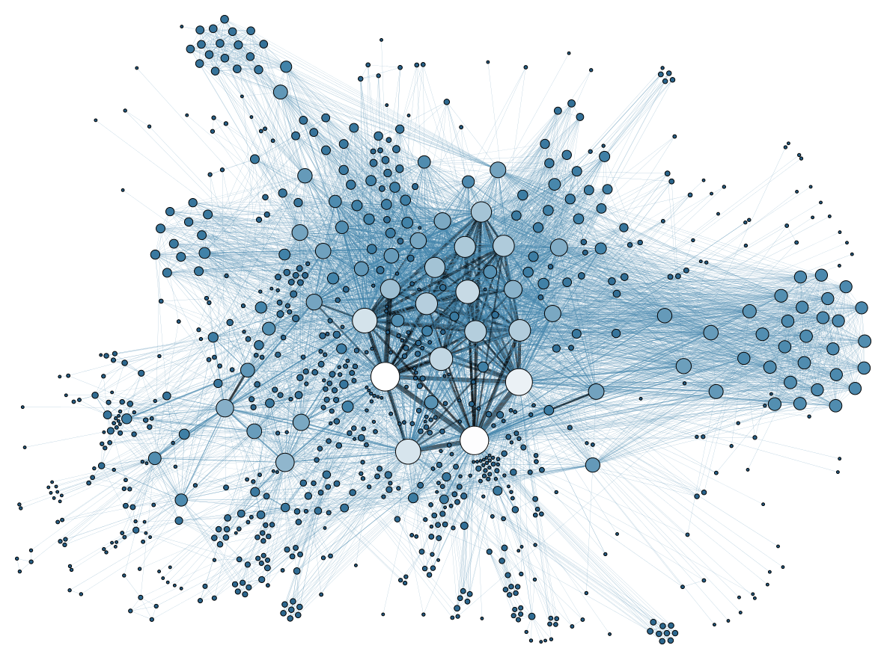
Key properties of whole networks
We have already seen three of the main ones:
  Number of nodes (graph order): N
  Number of links (graph size): E
  Density: E / (N(N-1)/2)

Slide 5
Key properties of whole networks
We will discuss additional ones:
  Degree based:
    Max/min degree
    Average degree: d_{avg}
    Degree distribution
    Degree Centralization: C_{d}
  Path based:
    Network Diameter: D
    Average shortest path: L
    Hierarchy: H
  Dyad based:
    Reciprocity: R
  Node based:
    Average clustering coefficient: c_{avg}

Slide 6
Degree-based network properties
A
A
E
B
C
E
B
C
D
D

Slide 7
Degree-based network properties
A
A
E
B
C
E
B
C
D
D
A | B | C | D | E
4 | 3 | 2 | 1 | 2
A | B | C | D | E
3 | 4 | 3 | 3 | 3
Degree Sequence
Degree Sequence

Slide 8
Degree-based network properties
A
d = (4 + 3 + 2 + 1 + 2) / 5
A
d = (3 + 4 + 3 + 3 + 3) / 5
E
B
C
E
B
C
D
D
A | B | C | D | E
4 | 3 | 2 | 1 | 2
Max degree: 4
Min degree: 1
A | B | C | D | E
3 | 4 | 3 | 3 | 3
Max degree: 4
Min degree: 3
Degree Sequence
Degree Sequence

Slide 9
Degree-based network properties
A
d = (4 + 3 + 2 + 1 + 2) / 5
A
d = (3 + 4 + 3 + 3 + 3) / 5
E
B
C
E
B
C
D
D
A | B | C | D | E
4 | 3 | 2 | 1 | 2
Max degree: 4
Min degree: 1
d = 2.4
A | B | C | D | E
3 | 4 | 3 | 3 | 3
Max degree: 4
Min degree: 3
d = 3.2
Degree Sequence
Degree Sequence

Slide 10
Degree-based network properties
A
d = (4 + 3 + 2 + 1 + 2) / 5
A
d = (3 + 4 + 3 + 3 + 3) / 5
E
B
C
E
B
C
D
D
A | B | C | D | E
4 | 3 | 2 | 1 | 2
Max degree: 4
Min degree: 1
d = 2.4
A | B | C | D | E
3 | 4 | 3 | 3 | 3
Max degree: 4
Min degree: 3
d = 3.2
Degree Sequence
Degree Sequence

Slide 11
Degree-based network properties
The degree distribution (p_{k}) is the probability of observing a node with degree k for each value of degree in the network!
A
A
E
B
C
E
B
C
D
D
1 | 2 | 3 | 4
1/5 | 2/5 | 1/5 | 1/5
0.2 | 0.4 | 0.2 | 0.2
Max degree: 4
Min degree: 1
d = 2.4
1 | 2 | 3 | 4
0/5 | 0/5 | 4/5 | 1/5
0 | 0 | 0.8 | 0.2
Max degree: 4
Min degree: 3
d = 3.2
Degree Distribution
Degree Distribution

Slide 12
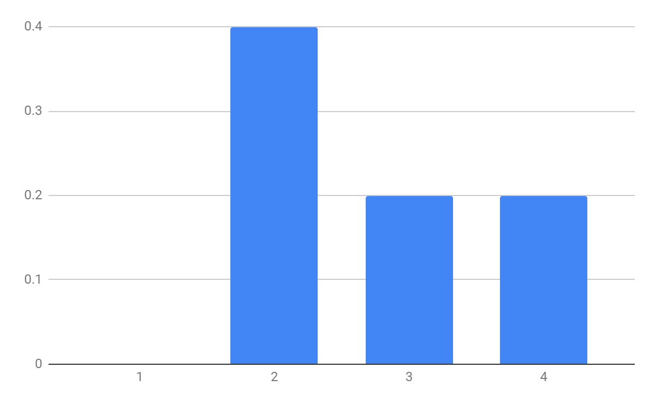
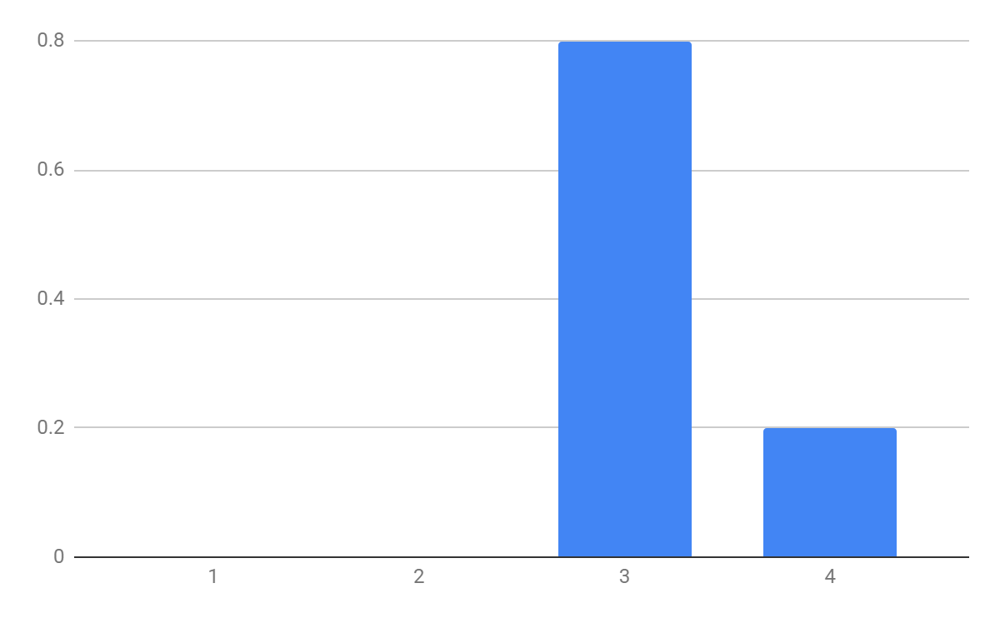
Degree-based network properties
1 | 2 | 3 | 4
0/5 | 2/5 | 1/5 | 1/5
0 | 0.4 | 0.2 | 0.2
Max degree: 4
Min degree: 1
d = 2.4
1 | 2 | 3 | 4
0/5 | 0/5 | 4/5 | 1/5
0 | 0 | 0.8 | 0.2
Max degree: 4
Min degree: 3
d = 3.2
Degree Distribution
Degree Distribution

Slide 13
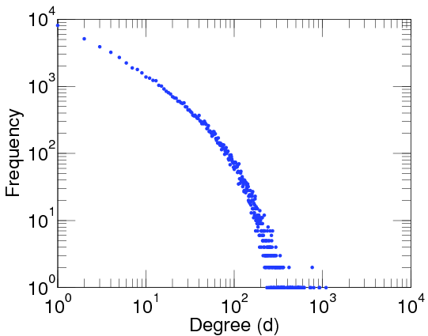
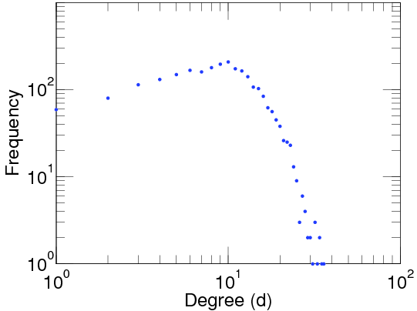
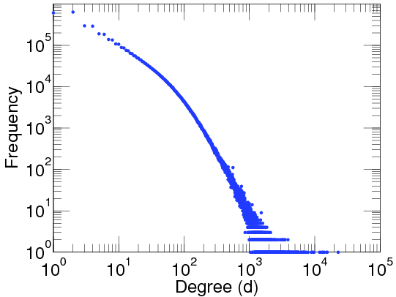
Degree-based network properties
Facebook Users
Add Health Study (High School)
LiveJournal Users
N = 63,731
E = 817,035
Max degree: 1,098
d = 25.6
N = 2539
E = 12,969
Max degree: 36
d = 10.2
N = 4,847,571
E = 68,475,391
Max degree: 22,887
d = 28.5

Slide 14
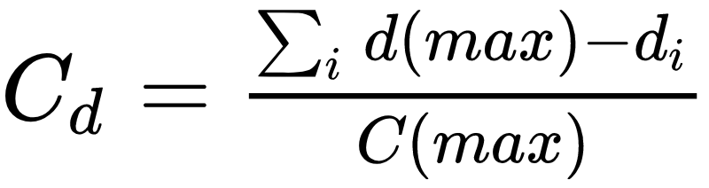
Degree-based network properties
Degree Centralization compares an observed network to one that is maximally centralized (the star graph of the same order)
A
A
E
B
C
E
B
C
D
D
A | B | C | D | E
4 - 1 | 4 - 4 | 4 - 1 | 4 -1 | 4 - 1
3 | 0 | 3 | 3 | 3
Max degree: 4
A | B | C | D | E
4 - 3 | 4 - 4 | 4 - 3 | 4 -3 | 4 - 3
1 | 0 | 1 | 1 | 1
Max degree: 4
Maximally Centralized Network (N = 5)
Observed Network
(N = 5)

Slide 15
Degree-based network properties
It is given by the sum of the differences between maximum degree and the degree of each node in the observed network to the same number in the star graph of the same size
A
A
E
B
C
E
B
C
D
D
A | B | C | D | E
4 - 1 | 4 - 4 | 4 - 1 | 4 -1 | 4 - 1
3 | 0 | 3 | 3 | 3
Max degree: 4
Sum of differences: 12
A | B | C | D | E
4 - 3 | 4 - 4 | 4 - 3 | 4 -3 | 4 - 3
1 | 0 | 1 | 1 | 1
Max degree: 4
Sum of differences: 4
Maximally Centralized Network (N = 5)
Observed Network
(N = 5)

Slide 16
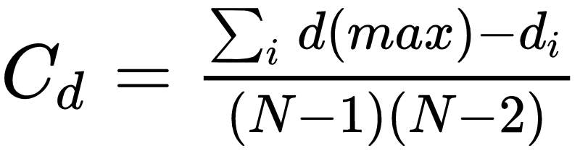
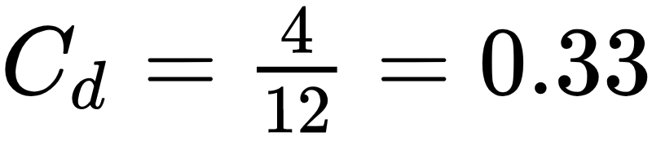
Degree-based network properties
It is given by the sum of the differences between maximum degree and the degree of each node in the observed network to the same number in the star graph of the same size
A
A
E
B
C
E
B
C
D
D
A | B | C | D | E
4 - 1 | 4 - 4 | 4 - 1 | 4 -1 | 4 - 1
3 | 0 | 3 | 3 | 3
Max degree: 4
Sum of differences: 12
(n-1)*(n-2)
A | B | C | D | E
4 - 3 | 4 - 4 | 4 - 3 | 4 -3 | 4 - 3
1 | 0 | 1 | 1 | 1
Max degree: 4
Sum of differences: 4
Maximally Centralized Network (N = 5)
Observed Network
(N = 5)

Slide 17
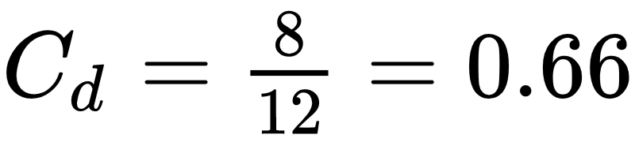
Degree-based network properties
It is given by the sum of the differences between maximum degree and the degree of each node in the observed network to the same number in the star graph of the same size
A
A
E
B
C
E
B
C
D
D
A | B | C | D | E
4 - 1 | 4 - 4 | 4 - 1 | 4 -1 | 4 - 1
3 | 0 | 3 | 3 | 3
Max degree: 4
Sum of differences: 12
(n-1)*(n-2)
A | B | C | D | E
4 - 2 | 4 - 4 | 4 - 2 | 4 -2 | 4 - 2
2 | 0 | 2 | 2 | 2
Max degree: 4
Sum of differences: 8
Maximally Centralized Network (N = 5)
Observed Network
(N = 5)

Slide 18
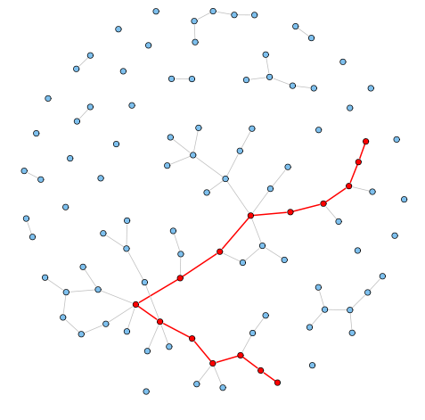
Path-based network properties
Flashback:
  In a network, shortest paths between two nodes are also called geodesics
The diameter (D) of a network is the length of the longest shortest path between two nodes
We can also compute the average shortest path length (L) between all pairs of nodes in a network
  Can only be computed for connected graphs or in the giant component of disconnected ones

Slide 19
Path-based network properties
Facebook Users
Add Health Study (High School)
LiveJournal
N = 63,731
E = 817,035
Max degree: 1,098
d = 25.6
D = 15
L = 4.3
N = 2539
E = 12,969
Max degree: 36
d = 10.2
D = 10
L = 4.5
N = 4,847,571
E = 68,475,391
Max degree: 22,887
d = 28.5
D = 20
L = 5.5

Slide 20
Path-based network properties
Facebook Users
Add Health Study (High School)
LiveJournal
N = 63,731
E = 817,035
Max degree: 1,098
d = 25.6
D = 15
L = 4.3
N = 2539
E = 12,969
Max degree: 36
d = 10.2
D = 10
L = 4.5
N = 4,847,571
E = 68,475,391
Max degree: 22,887
d = 28.5
D = 20
L = 5.5
L is small!

Slide 21
Path-based network properties
The reachability matrix of a graph has a one in each cell if the corresponding pair of nodes are connected via a path of some length
Reachability matrix
A
 | A | B | C | D | E
A | -- | 1 | 1 | 0 | 1
B | 1 | -- | 1 | 0 | 1
C | 1 | 1 | -- | 0 | 1
D | 0 | 0 | 0 | -- | 0
E | 1 | 1 | 1 | 0 | --
E
B
C
D

Slide 22
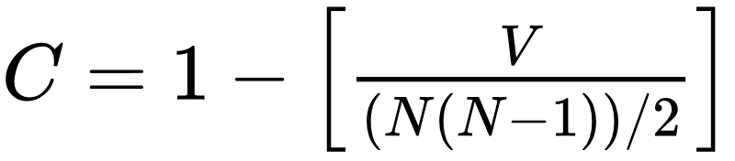
Path-based network properties
Connectedness (C) is the pairwise connectivity of nodes in a network
  Defined as one minus the number of pairs that cannot reach one another (V) divided by the total number of possible pairs:
Reachability matrix
A
 | A | B | C | D | E
A | -- | 1 | 1 | 0 | 1
B | 1 | -- | 1 | 0 | 1
C | 1 | 1 | -- | 0 | 1
D | 0 | 0 | 0 | -- | 0
E | 1 | 1 | 1 | 0 | --
E
B
C
D

Slide 23
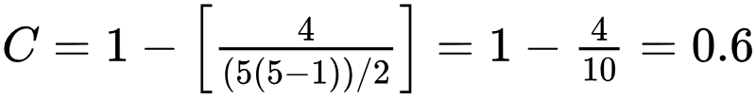
Path-based network properties
Connectedness (C) is the pairwise connectivity of nodes in a network
  Defined as one minus the number of pairs that cannot reach one another (V) divided by the total number of possible pairs:
Reachability matrix
A
 | A | B | C | D | E
A | -- | 1 | 1 | 0 | 1
B | 1 | -- | 1 | 0 | 1
C | 1 | 1 | -- | 0 | 1
D | 0 | 0 | 0 | -- | 0
E | 1 | 1 | 1 | 0 | --
E
B
C
D

Slide 24
Path-based network properties
Hierarchy (H) measures anti-symmetry in a network
Hierarchy implies that only entries in the upper triangle of the reachability matrix have ones in them!
Reachability matrix
A
 | A | B | C | D | E
A | -- | 1 | 1 | 1 | 1
B | 0 | -- | 0 | 1 | 1
C | 0 | 0 | -- | 1 | 0
D | 0 | 0 | 0 | -- | 0
E | 0 | 0 | 0 | 0 | --
B
C
E
D

Slide 25
Path-based network properties
Hierarchy (H) measures anti-symmetry in a network
Reachability matrix
A
 | A | B | C | D | E
A | -- | 1 | 1 | 1 | 1
B | 1 | -- | 1 | 1 | 1
C | 0 | 0 | -- | 1 | 0
D | 0 | 0 | 0 | -- | 0
E | 1 | 1 | 1 | 1 | --
Hierarchy violations appear as entries on the lower diagonal!
This implies that these nodes are now mutually reachable
B
C
E
D

Slide 26
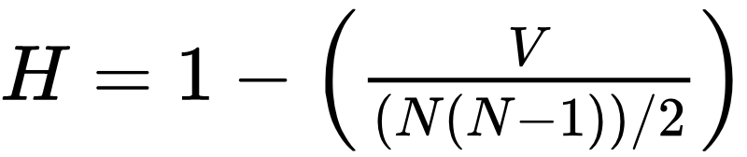
Path-based network properties
Hierarchy (H) measures anti-symmetry in a network
  We can measure hierarchy as one minus the total number of anti-symmetry violating entries (V) in the lower diagonal divided by the possible number of pairs
Reachability matrix
A
 | A | B | C | D | E
A | -- | 1 | 1 | 1 | 1
B | 1 | -- | 1 | 1 | 1
C | 0 | 0 | -- | 1 | 0
D | 0 | 0 | 0 | -- | 0
E | 1 | 1 | 1 | 1 | --
Hierarchy violations appear as entries on the lower diagonal!
This implies that these nodes are now mutually reachable
B
C
E
D

Slide 27
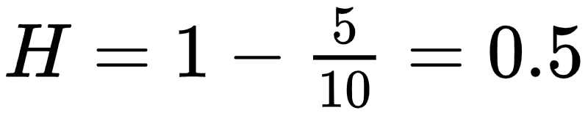
Path-based network properties
Hierarchy (H) measures anti-symmetry in a network
  We can measure hierarchy as one minus the total number of anti-symmetry violating entries (V) in the lower diagonal divided by the possible number of pairs
Reachability matrix
A
 | A | B | C | D | E
A | -- | 1 | 1 | 1 | 1
B | 1 | -- | 1 | 1 | 1
C | 0 | 0 | -- | 1 | 0
D | 0 | 0 | 0 | -- | 0
E | 1 | 1 | 1 | 1 | --
Hierarchy violations appear as entries on the lower diagonal!
This implies that these nodes are now mutually reachable
B
C
E
D

Slide 28
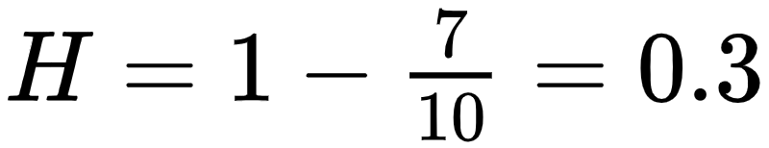
Path-based network properties
Hierarchy (H) measures anti-symmetry in a network
  We can measure hierarchy as one minus the total number of anti-symmetry violating entries (V) in the lower diagonal divided by the possible number of pairs
Reachability matrix
A
 | A | B | C | D | E
A | -- | 1 | 1 | 1 | 1
B | 1 | -- | 1 | 1 | 1
C | 1 | 1 | -- | 1 | 1
D | 0 | 0 | 0 | -- | 0
E | 1 | 1 | 1 | 1 | --
The more violations the less hierarchy!
B
C
E
D

Slide 29
Dyad-based network properties
Reciprocity (R) measures whether relations go both ways in the network
  Reciprocity (R) is given by counting the number of mutual links (V) in the adjacency matrix and dividing by the total number of existing ties (E)
Adjacency matrix
A
 | A | B | C | D | E
A | -- | 1 | 1 | 0 | 0
B | 0 | -- | 0 | 1 | 1
C | 1 | 0 | -- | 1 | 1
D | 0 | 1 | 1 | -- | 0
E | 1 | 0 | 0 | 0 | --
Mutual ties appear as symmetrical entries in the adjacency matrix!
In a matrix the entries A_{ij} and A_{ji} are symmetrical
B
C
E
D

Slide 30
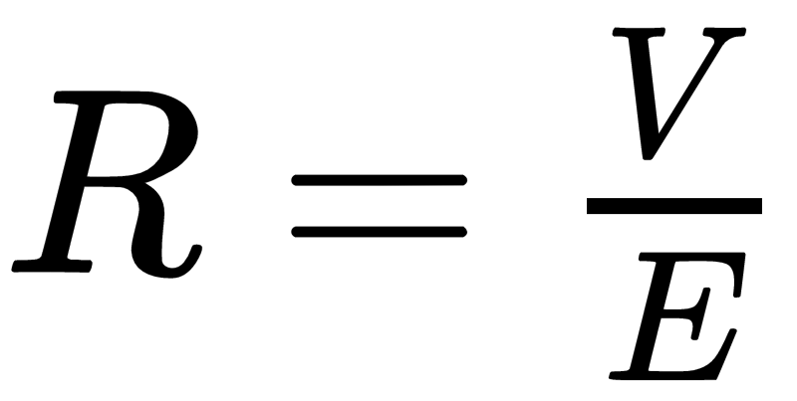
Dyad-based network properties
Reciprocity (R) measures whether relations go both ways in the network
  Reciprocity (R) is given by counting the number of reciprocal links (V) in the adjacency matrix and dividing by the total number of existing ties (E)
Adjacency matrix
A
 | A | B | C | D | E
A | -- | 1 | 1 | 0 | 0
B | 0 | -- | 0 | 1 | 1
C | 1 | 0 | -- | 1 | 1
D | 0 | 1 | 1 | -- | 0
E | 1 | 0 | 0 | 0 | --
B
C
Looks like we have six reciprocal links out of a total of 10 links
E
D

Slide 31
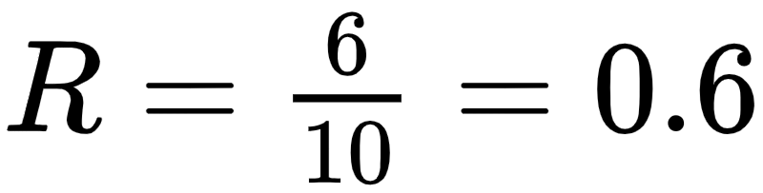
Dyad-based network properties
Reciprocity (R) measures whether relations go both ways in the network
  Reciprocity (R) is given by counting the number of reciprocal links (V) in the adjacency matrix and dividing by the total number of existing ties (E)
Adjacency matrix
A
 | A | B | C | D | E
A | -- | 1 | 1 | 0 | 0
B | 0 | -- | 0 | 1 | 1
C | 1 | 0 | -- | 1 | 1
D | 0 | 1 | 1 | -- | 0
E | 1 | 0 | 0 | 0 | --
B
C
Looks like we have six reciprocal links out of a total of 10 links
E
D

Slide 32
Dyad-based network properties
Facebook Users
Add Health Study (High School)
LiveJournal
N = 63,731
E = 817,035
Max degree: 1,098
d = 25.6
D = 15
L = 4.3
R = 1.0
N = 2539
E = 12,969
Max degree: 36
d = 10.2
D = 10
L = 4.5
R = 0.38
N = 4,847,571
E = 68,475,391
Max degree: 22,887
d = 28.5
D = 20
L = 5.5
R = 0.75

Slide 33


Node-based network properties
Flashback:
  Clustering coefficient at the ego-network level:
  Where g_{jk} = 1 if i's j^{th} neighbor is connected to her k^{th} neighbor, and k_{i} is i's total number of neighbors.
The Average Clustering Coefficient at the network level is just the sum of each node’s clustering coefficient divided by total number of nodes:

Slide 34
Node-based network properties
Facebook Users
Add Health Study (High School)
LiveJournal
N = 63,731
E = 817,035
Max degree: 1,098
d = 25.6
D = 15
L = 4.3
R = 1.0
C = 0.15
N = 2539
E = 12,969
Max degree: 36
d = 10.2
D = 10
L = 4.5
R = 0.38
C = 0.14
N = 4,847,571
E = 68,475,391
Max degree: 22,887
d = 28.5
D = 20
L = 5.5
R = 0.75
C = 0.12

Slide 35
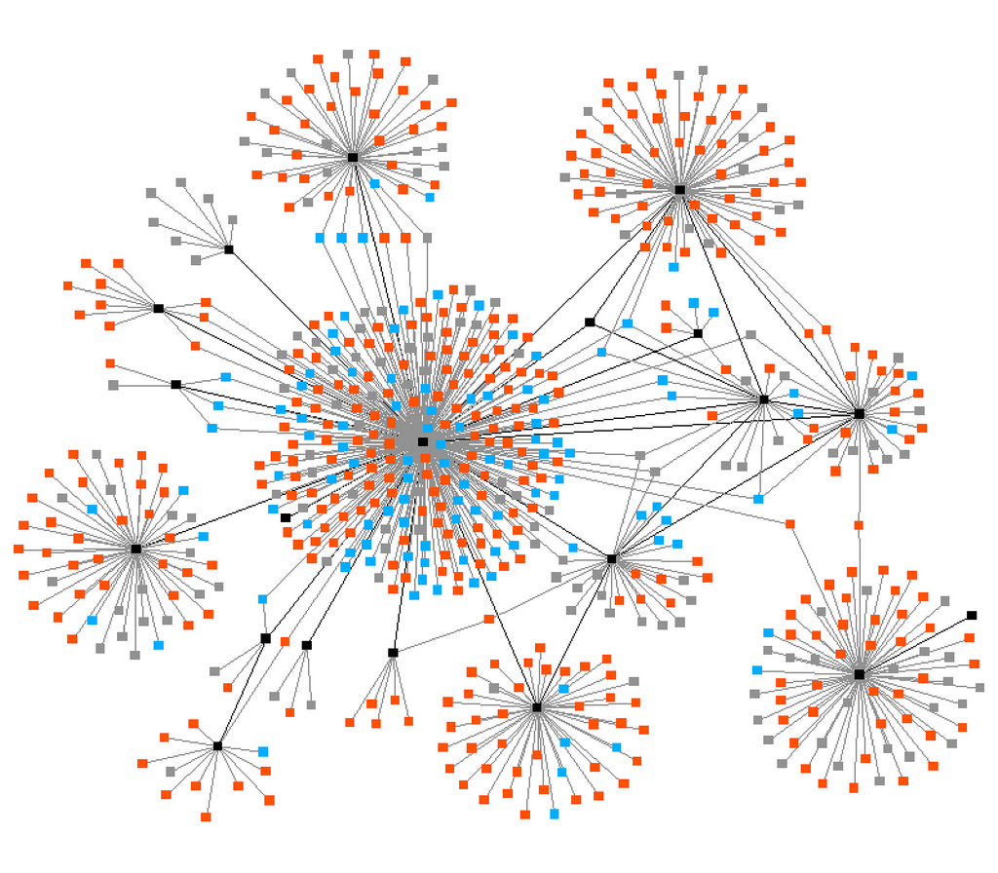
The small world phenomenon
A given (large-scale) network is a "small world" if:
  The order of the graph (N) is large
  The graph is sparse (any node is on average connected to only a relatively small number of other nodes k)
    k ~ 10² in human social networks (Pool and Kochen 1978)
  Graph is decentralized (max degree is much smaller than the order of the graph N)
  The network exhibits clustering (friends of friends tend to be friends)

Slide 36

The small world phenomenon
Classic study by Travers and Milgram (1969)
Target (Boston stockbroker)
  296 participants ("starting persons")
  196 from Nebraska
    100 Stockbrokers
    96 Random
  100 from Boston
  217 forwarded packet so get to target person
  453 Intermediaries enlisted by the participants

Slide 37

The small world phenomenon
Target (Boston stockbroker)
  296 participants ("starting persons")
  196 from Nebraska
    100 Stockbrokers
    96 Random
  100 from Boston
  217 forwarded packet so get to target person
  453 Intermediaries enlisted by the participants
64 completed chains (29%)
    Mean path length: 5.2

Slide 38

The small world phenomenon
Target (Boston stockbroker)
  296 participants ("starting persons")
  196 from Nebraska
    100 Stockbrokers
    96 Random
  100 from Boston
  217 forwarded packet so get to target person
  453 Intermediaries enlisted by the participants
232 incomplete chains (71%)
  Mean path length: 2.6

Slide 39
The small world phenomenon
Out of the 64 completed chains 26 people made the final link
16 (25%) reached the target via a single neighbor: "Mr. G."
  Another accounted for 10
  Another for 5
  The top three account for 48% of completions
86% of “starters” sent the letter to friends and acquaintances
  14% send it to relatives
  age, gender, SES homophily in Intermediary choice

Slide 40
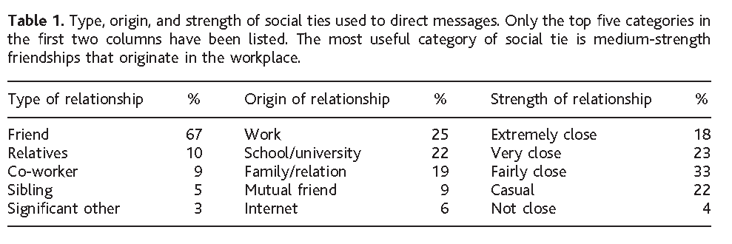
The small world phenomenon
Dodds, Muhamad and Watts (2003) Replication of Milgram
  Internet based social experiment
    18 target persons from 13 countries randomly allocated
    98,847 participants registered, 25% initiated a chain
    61,168 total participants from 166 countries (including intermediaries)

Slide 41
The small world phenomenon
Dodds, Muhamad and Watts (2003) Replication of Milgram
  More than half from North America
    Middle Class
    Professional, College Educated
    Largely Christian

Slide 42
The small world phenomenon
Dodds, Muhamad and Watts (2003) Replication of Milgram
  Strong preference for:
    Friends as role relations (rather than kin or co-workers)
    Ties embedded in work and school affiliations
    Ties of Intermediate strength (closeness)
    Same-gender ties

Slide 43
The small world phenomenon
Dodds, Muhamad and Watts (2003) Replication of Milgram
  Most effective chains more likely to feature:
    Professional ties (in contrast to friend and kin) as role relations
    Work or higher education ties as foci
    Either causal or “not close” ties in terms of strength
      Why this pattern?

Slide 44
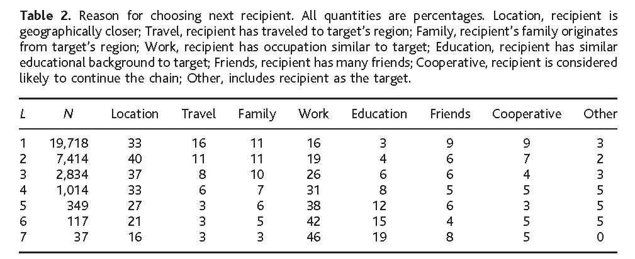
The small world phenomenon
Dodds, Muhamad and Watts (2003) Replication of Milgram
  Geographic proximity and similarity of occupation were the primary search heuristics
    Number of friends ("hub heuristic") almost never used
    Proximity declines and homophily increases in importance with chain length

Slide 45
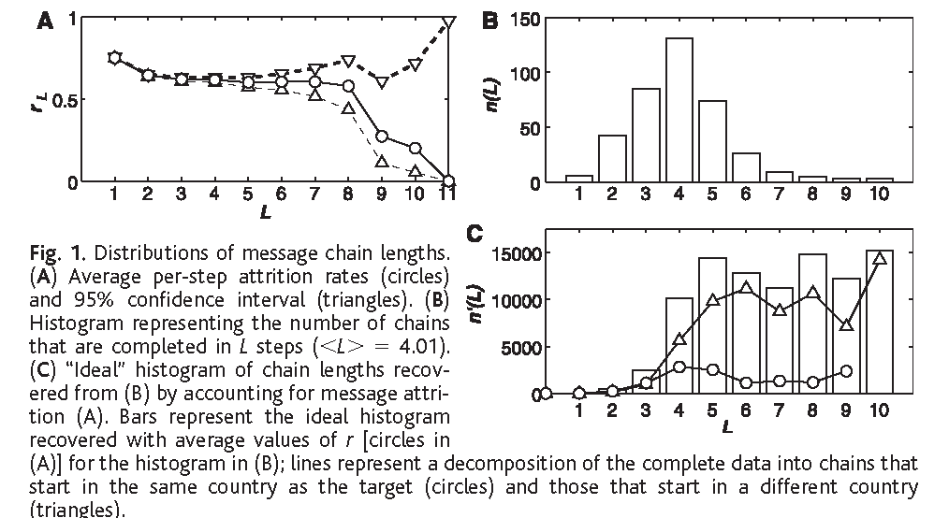
The small world phenomenon
384 completed chains (out 24,163); Average (L): 4.05
Corrected for attrition the median chain length is between 5 and 7

